Slide 1
Marching Band of Pirates (MBOP) Registration
Welcome, we’re glad you are here

Slide 2
What you’ll need to do tonight!
Register
Mandatory Documents
Payment
Charms Verification

Slide 3
Step 1
Computers can be found in the back of the Auditorium for you to use for completion of the Registration Form.
Registration
Registration information is critical for you and your student. All band and band booster records will use this information for communication with you about all Marching Band of Pirates(MBOP), Band, and Guard activities.
Please ensure all your information is accurate and complete. We can’t communicate with you if we can’t reach you.

Slide 4
Step 2
Returning MBOP members will need to have their Charms accounts checked before registration.
Registration
Charms Verification
Charms verification for returning members can be found along the side of the auditorium.
Over there
Braden River Band Boosters Association(BRBBA) policy prohibits students from registering for a new MBOP season with an outstanding balance

Slide 5
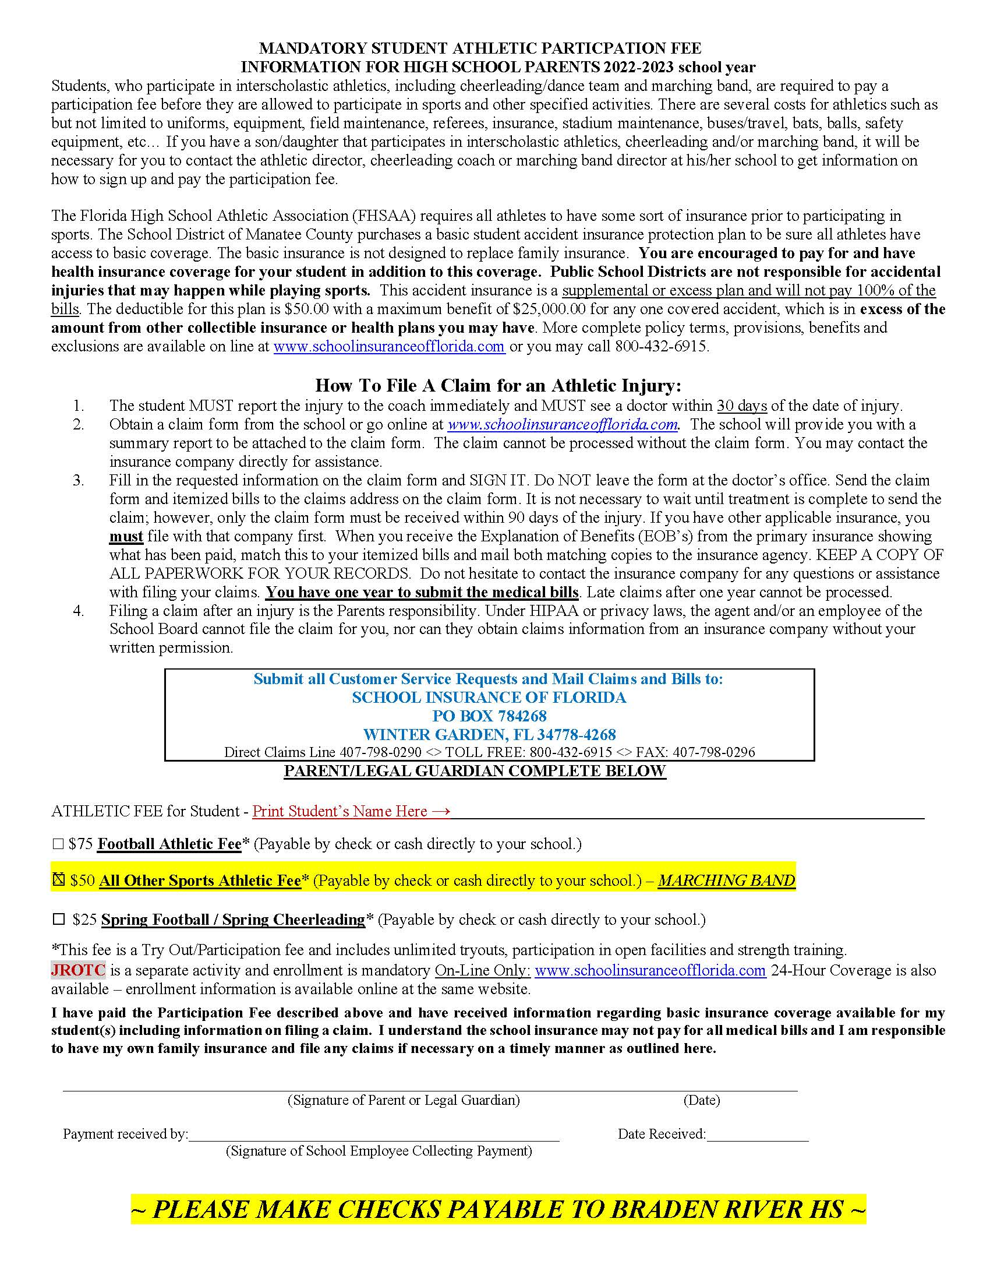
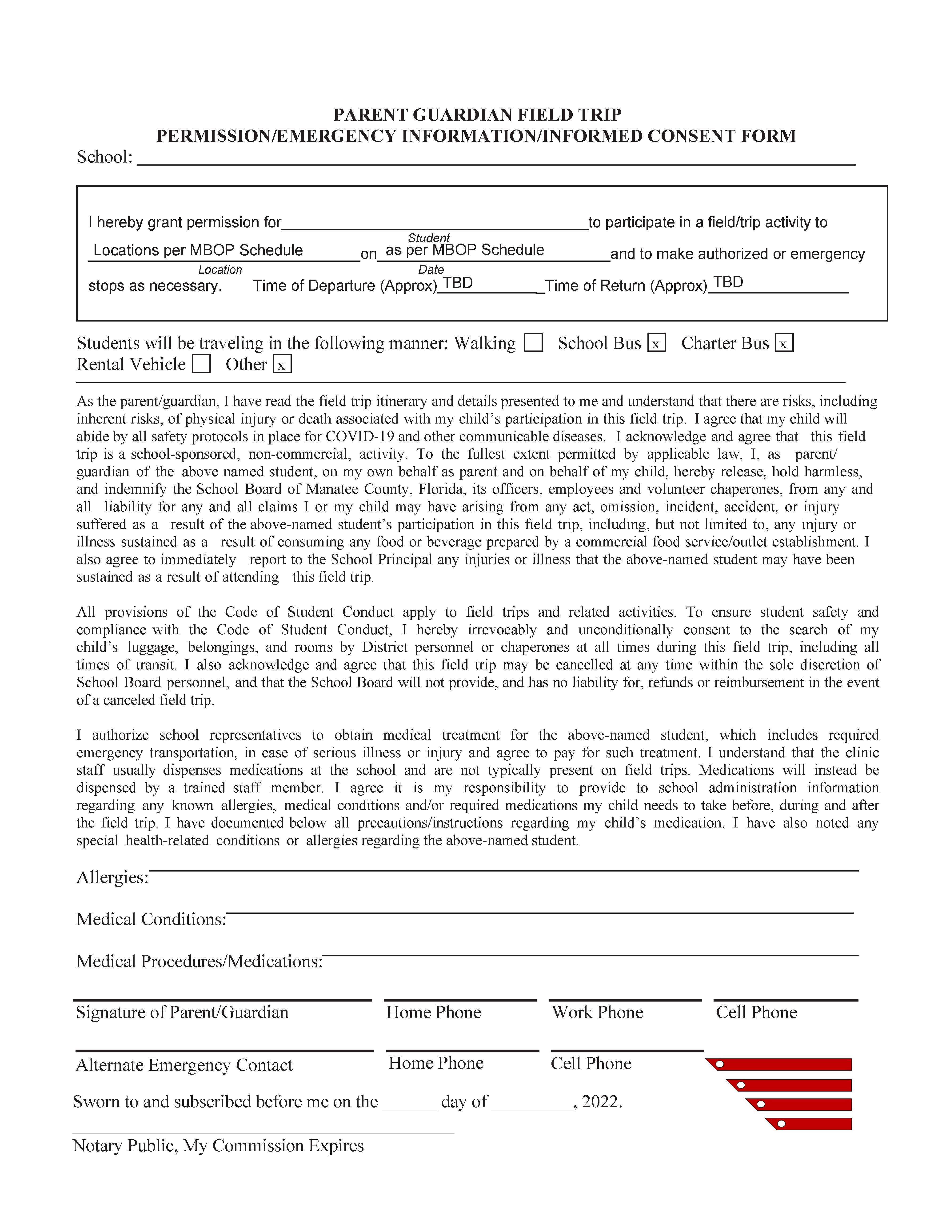
The School District of Manatee County (SDMC) requires all students who participate in marching band to purchase athletic insurance prior to their participation.
Step 3
Mandatory Documents
Registration
Charms Verification
Collect and complete these forms in front of the stage.
Braden River High School will additionally require a field trip permission slip for all MBOP affiliated events. We require one all encompassing form for the year. We have a notary here tonight for your convenience.

Slide 6
Step 4
A deposit of $100 is required tonight to secure a spot in the Marching Band of Pirates.
Payment is the last step and is made on stage. Please complete all steps before coming on stage.
Mandatory Documents
Registration
Charms Verification
Payment
The Braden River Band Booster Association requires a credit card to be kept on file for incidentals and timely payments throughout the season. Types of incidentals include items like: meals, apparel, and equipment.

Slide 7
The Schedule!
www.brhsbands.org/calendar has every date for all MBOP, Band, and Guard activities throughout the year. Please favorite it!
You’ll also find the MBOP Detailed Daily Schedule that provides a minute-by-minute schedule of MBOP events.

Slide 8
Summer Dates
Drumline Placements: May 6-9th (5pm – 7pm)
Colorguard Introduction/Open House - May 6th-9th (4pm – 7pm)
Winds and Percussion Camp: May 28th – 31st (9am – 5pm)
Colorguard Camp: June 3rd – 7th (9am – 5pm)
Summer Rehearsals: June 26, July 3, 10, 17(4pm – 8pm)
Band Camp Week 1: July 22 – July 26 (9am – 5pm)
Band Camp Week 2: July 29 – Aug 2 (9am – 9pm)
Very important for students to attend all summer dates

Slide 9
Charms!
Is a program/database for all band and guard information.
An account will be created for you/your student(s) after tonight’s registration.
You can find all financial information, volunteer opportunities, and much more here.
Instructions for signing in will be sent to you in the coming weeks.

Slide 10
Speaking of Volunteering!
Chaperoning
Making meals
Serving Meals
Ordering food
Buying food
Sewing
Working football concessions
Running the marching band and colorguard competitions
Uniform fittings
Washing uniforms
Building props
Towing trailers
Pushing/pulling equipment at shows
Fundraising
PR and Marketing
Finding sponsors
Taking pictures
And MUCH more….
The Marching Band of Pirates NEED your help. We can’t function without it. Here is just a small list of what we need your help with:
Most importantly, the students need your support! Show up to a show, volunteer, cheer them on!

Slide 11
Questions?
There are many BRBBA members and Band Staff in attendance tonight. If you have questions, please ask, we are here to help!
Cliff Dawson – Director of Bands
Ricardo Robinson-Shinall – Colorguard Director
Chuck Knapp – President
Scott Close – Treasurer
Jennifer Hubley - Secretary
Jessica Eastman– Color Guard Rep

Slide 12
Thank you for attending!
2024 Reveal @ 7:45pm

