Slide 1
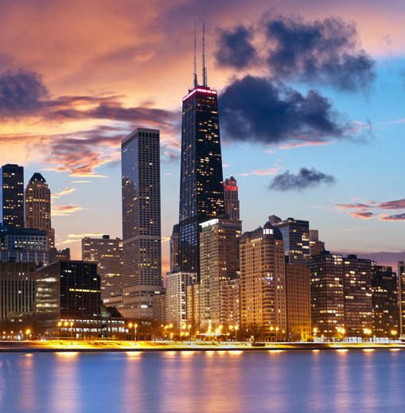
CHICAGO
BRADEN RIVER HIGH SCHOOL BAND
MARCH 13-16, 2025

Slide 2
BRT: Since 1981
Founded and owned by a band director
Carried over 650,000 travelers in over 8,000 trips
Disney Youth Programs PremEar Travel Planner
The top producer for Disney Performing Arts OnStage programs at the Walt Disney World® Resort
Recipient of Disney’s prestigious Partners Award
Member of the Student & Youth Travel Association and the National Tour Association
Sponsor of the Illinois Music Education Association, the National Band Association, the American Choral Directors Association, among others
Corporate sponsor of the Make-A-Wish Foundation

Slide 3
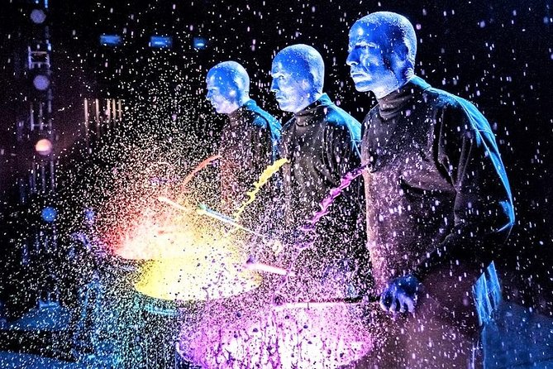
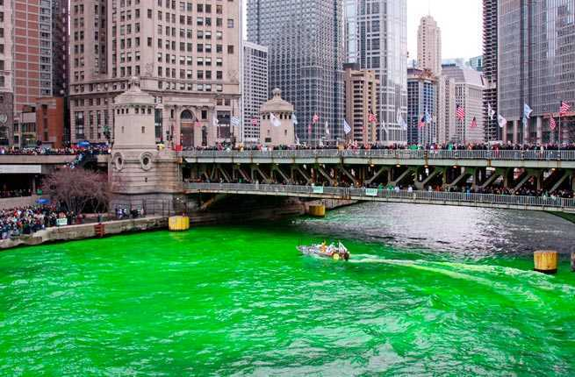
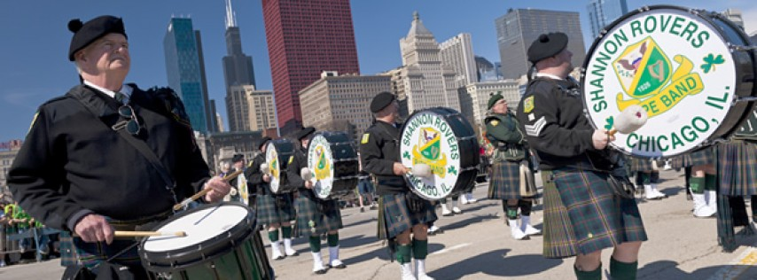
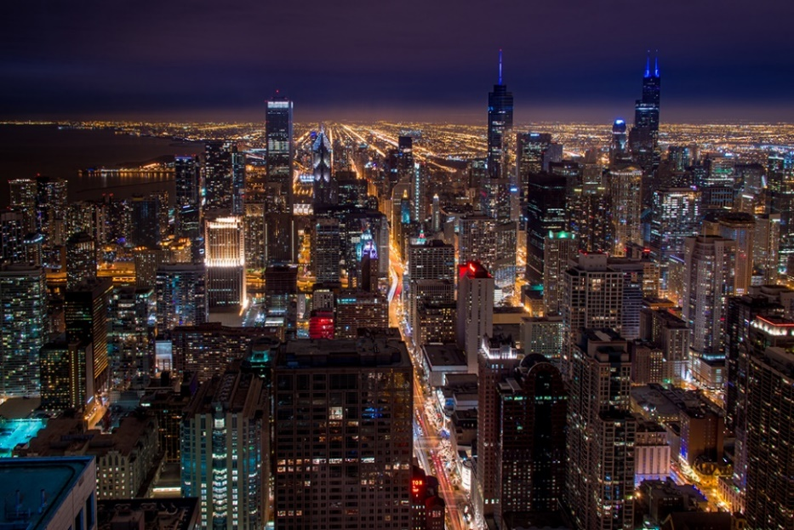
Itinerary Highlights

Slide 4
Trip Inclusions
Round-Trip Airfare (based on $600 airfare), Luggage Tags, Company Representative for airport check-in
2-56 passenger motor coaches in Chicago, gratuities and accommodations for motor coach drivers
3 nights’ accommodations at Crowne Plaza Burr Ridge; Breakfasts at hotel
2 Dedicated overnight security chaperones
Group Meals at Ed Debevic’s, Giordano’s, Pinstripes, meal voucher at Navy Pier, and boxed lunch on parade day
Admission to 360 Chicago and Tilt, Pinstripes bowling, Museum of Science and Industry
Excursions to Magnificent Mile, Millennium Park, Navy Pier
Ticket to Blue Man Group
Performance in the St. Patrick’s Day Parade (based on application and acceptance)
Onsite Company Tour Director, All Gratuities throughout the Tour
BRT Video Souvenir & Tracking/Messaging App
BRT Drawstring Bag for every participant
BRT Payments – Online Payment System

Slide 5
Estimated Trip Cost & Payment Schedule –
**Final Trip Cost depends on number of travelers and cost of airfare
Participant Type | Occupancy
Student (90-99 participants) | $1,565 (all students in quad occupancy)
Chaperone* | $1,685 (double) $1,935 (single)
Payment Details | Due Date | Amount Due
Registration | July 31 | No money due
Deposit | August 7 | $175 per traveler plus optional trip protection
2nd Payment | September 16 | $280 per traveler
3rd Payment | October 15 | $280 per traveler
4th Payment | November 15 | $280 per traveler
5th Payment | January 3 | $280 per traveler
Final Payment | February 3 | Remaining Balance
*All chaperones will register as single occupancy. If you have another chaperone you wish to room with, contact your director to be moved into double occupancy.

Slide 6
BRT Payments – How to Register for the Trip
Click on the registration link from the registration form handout:
https://bobrogerstravel.grcoll.co/v2/go/bradenriver25 - TRIP CODE BRADENRIVER25
Follow the steps from the registration form to register. Reserve your spot by entering all information requested in RED and enter a payment method. *A parent must register their child. We will email you along the way – messages may go to spam. Please check your spam folder.
**Complete all the steps (personal & billing information) for your spot to be confirmed (Partial registrations will cause your trip to be cancelled)
You can add Enhanced Trip Protection through TripMate when you register – Enhanced Trip Protection is highly recommended
Secure, online payment system
Receive reminder prior to each payment, select auto-pay for ease
Fund-raising amounts can be easily applied to your account until your account is paid in full
Estimated Trip Cost will depend on number of travelers and the final cost of airfare. The more people that go, the lower the cost will be! (If fewer than 90 attend, the cost could increase)

Slide 7
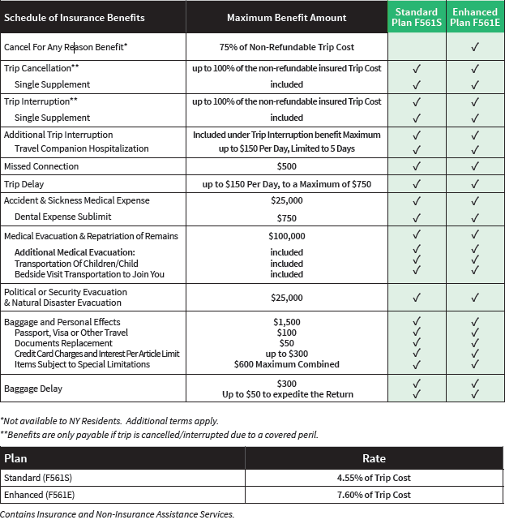
Enhanced (Cancel-For-Any-Reason) Trip Protection
Enhanced Trip Protection is highly recommended and can be added when you register for the trip.
See flyer for coverage details.
As part of your trip registration, you will choose Standard Protection, Enhanced Protection, or decline protection.
Your insurance premium will be charged when you make your trip deposit.
If you want to add Enhanced Trip Protection later, you can log into your account up to 14 days after your deposit to add it.
Questions? A licensed insurance agent can help you when you call the number on the flyer - (844) 777-6856

Slide 8
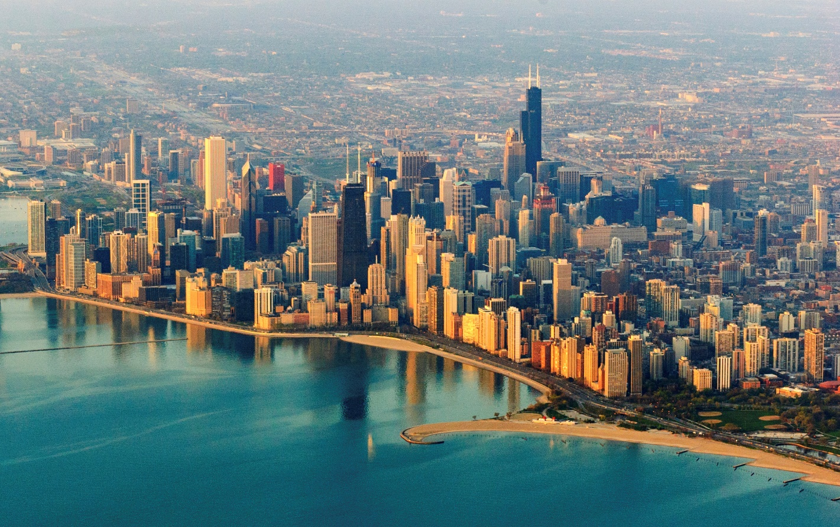
Files You Will Receive
Itinerary
TripMate Insurance Flyer
Registration Form
Go online and reserve your spot tonight!

